Slide 1
MODULE 5
Discourse - Introduction

Slide 2
Introduction to Discourse
Discourse comes from Latin word 'discursus’
Discourse: language consists of collocated, related groups of sentences. We refer to such a group of sentences as a discourse
Discourse: Novels, as well as short conversations or groans(cries)

Slide 3
What is Discourse?
language above the sentence or above the clause
a continuous stretch of spoken language larger than a sentence,
often constituting a coherent unit
a stretch of language perceived to be meaningful unified, and
purposive; language in use
(viewed) as social practice determined by social structures.
Discourses of food
“Healthy Food”
Social Practice
Healthy lifestyle

Slide 4
Structural Definition - Discourse
Structural or textual - Discourse is a particular unit of language (above the sentence)
Find the constituents that have particular relationships with each other and that can occur in a restricted number of arrangements;
Problems: units in which people speak do not always look like sentences, or grammatically correct sentences.
Example 1: (From “The Colour Purple”, Alice Wharton)
Jack is tall and kind and don't hardly say anything. Love children. Respect his wife, Odessa, and all Odessa Amazon sisters (Celie’s Diary)

Slide 5
Structural Definition - Discourse
Solving the problem: adopt Lyons’s distinction between system- sentences and text – sentences.
System sentences are well-formed abstract the oretical sentences generated according to the existing grammar rules;
Text-sentences are context-dependent utterances or parts of
utterances which occur in everyday life.
The discourse analysis will be concerned with text-sentences.

Slide 6
Functional Definition - Discourse
Functional - Discourse is a particular focus of language use.
Roman Jakobson: language performs six functions:
Addressor(emotive);
Context (referential)
Addressee (conative);
Contact (phatic);
Message (poetic);
Code (metalinguistic).
Utterances may have multiple functions;
The major concern: discourse analysis can turn out into a more general and broader analysis of language functions. Or it will fail to make a special place for the analysis of relationships between utterances.

Slide 7
Discourse
There are two basic forms of discourse:
Monologue;
Dialogue;
We will focus on techniques commonly applied to the interpretation of
monologues.
Monologue : The communication flows in only one direction in a monologue, i.e., from the speaker to the hearer.
Dialogue : consist of a much freer interchange. In this case, each participant periodically takes turns being a speaker and hearer.

Slide 8
Reference Resolution
Reference: the process by which speakers use expressions to denote an entity. (E.g. Ram and he – denotes a person named Ram)
Referring expression: natural language expression used to perform reference
Referent: the entity that is referred to (Ram and he - are referring expressions, and Ram is their referent)
Coreference: referring expressions that are used to refer to the same entity.
(Ram and he are co-refer & Ram is the antecedent of he)
Anaphora: reference to a previously introduced entity and the referring expression used is said to be anaphoric. (pronouns he and it are therefore anaphoric)

Slide 9
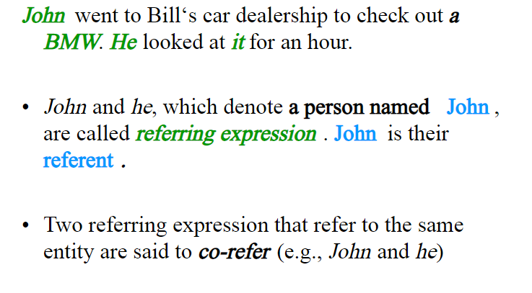
EXAMPLE

Slide 10
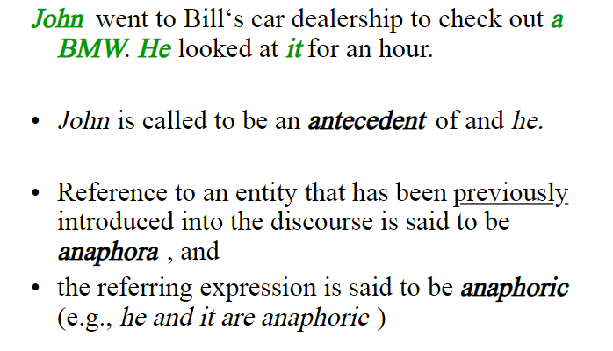
EXAMPLE

Slide 11
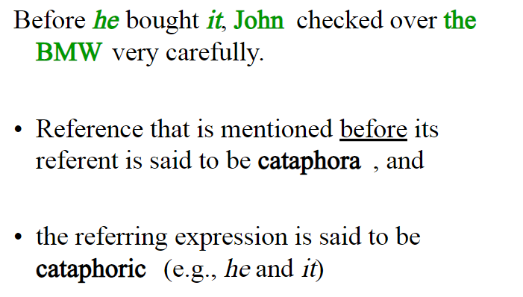
EXAMPLE

Slide 12
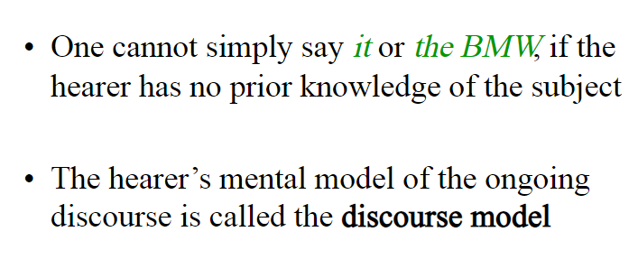
Discourse Analysis

Slide 13
Coreference resolution.
The goal of deciding what pronouns and other noun phrases refer to is called coreference resolution.
Coreference resolution is important for information extraction, summarization, and for conversational agents.

Slide 14
Summarization
Consider the task of summarizing the following news passage:
First Union Corp is continuing to wrestle with severe problems. According to industry insiders at Paine Webber, their president, John R. Georgius, is planning to announce his retirement tomorrow.
We might want to extract a summary like the following:
First Union President John R. Georgius is planning to announce his retirement
tomorrow.
In order to build such a summary, we need to know that the second sentence is the more important of the two, and that the first sentence is subordinate to it, just giving background information. Relationships of this sort between sentences in a discourse are called coherence relations, and determining the coherence structures between discourse sentences is an important discourse task

Slide 15
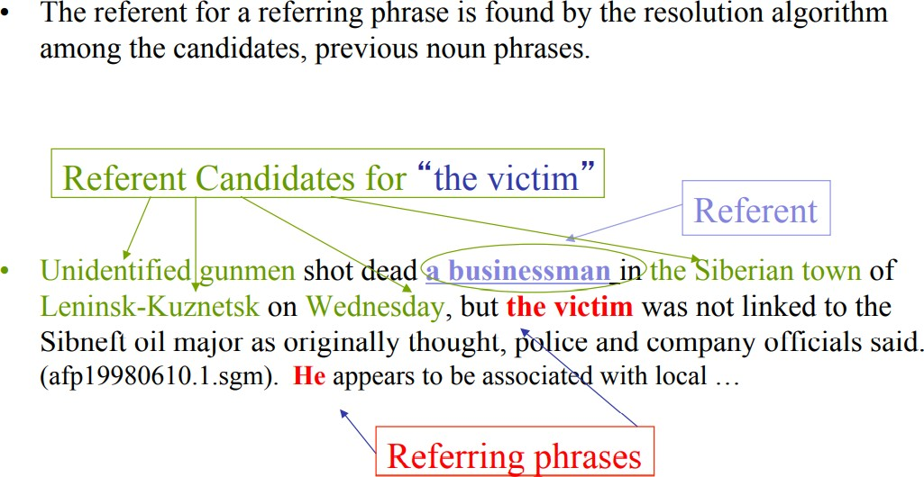
Terminology Examples

Slide 16
Reference Resolution
Discourse Model
It contains representations of the entities that have been referred to in the discourse and the relationships in which they participate.
Two components required by a system to produce and interpret referring expressions.
A method for constructing a discourse model that evolves dynamically.
A method for mapping between referring expressions and referents.

Slide 17
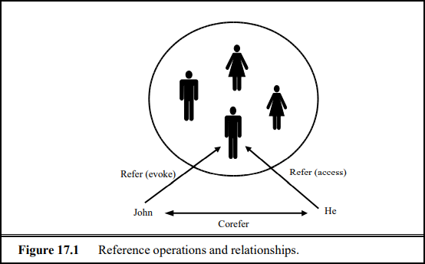
Reference Operations and Relationships

Slide 18
Reference Operations and Relationships
According to John, Bob bought Sue an Integra, and Sue bought Fred a Legend.
But that turned out to be a lie.
But that was false.
That struck me as a funny way to describe the situation.
That caused Sue to become rather poor.
That caused them both to become rather poor.
The referent of that is a speech act in (a), a proposition in (b), a manner of description in (c), an event in (d), and a combination of several events in (e).
The field awaits the development of robust methods for interpreting these types of reference.

Slide 19
Reference Phenomena
Five common types of referring expression
Type | Example
Indefinite noun phrase | I saw a Ford Escort today.
Definite noun phrase | I saw a Ford Escort today. The Escort was white.
Pronoun | I saw a Ford Escort today. It was white.
Demonstratives | I like this better than that.
One-anaphora | I saw 6 Ford Escort today. Now I want one.
Three types of referring expression that complicate the reference resolution
Type | Example
Inferrables | I almost bought a Ford Escort, but a door had a dent.
Discontinuous Sets | John and Mary love their Escorts. They often drive them.
Generics | I saw 6 Ford Escorts today. They are the coolest cars.

Slide 20
Indefinite noun phrase
Indefinite reference introduces entities that are new to the hearer into the discourse context.
The most common form of indefinite reference is marked with the determiner a (or an), but it can also be marked by a quantifier such as
some or even the determiner this
I saw an Acura Integra today.
Some Acura Integras were being unloaded at the local dealership today.
I saw this awesome Acura Integra today

Slide 21
Definite Noun
Definite Noun Phrases Definite reference is used to refer to an entity that
is identifiable to the hearer, either because it has already been mentioned in
the discourse context
it is contained in the hearer’s set of beliefs about the world, or the uniqueness of the object is implied by the description itself.
I saw an Acura Integra today. The Integra was white and needed to be washed.

Slide 22
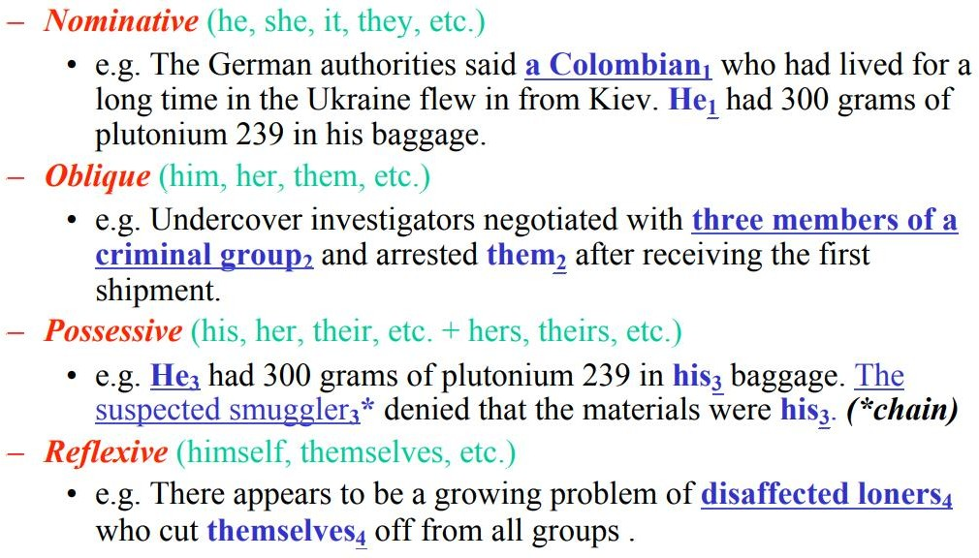
Pronoun : Reference Phenomena
Pronouns refer to entities that were introduced fairly recently

Slide 23
Demonstratives
Demonstrative pronouns, like this and that, behave somewhat differently than simple definite pronouns like it.
They can appear either alone or as determiners, for instance, this Acura, that Acura.
The choice between two demonstratives is generally associated with some notion of spatial proximity: this indicating closeness and that signaling distance. Spatial distance might be measured
John shows Bob an Acura Integra and a Mazda Miata
Bob (pointing): I like this better than that.

Slide 24
One Anaphora
One Anaphora, exemplified in , blends properties of definite and indefinite reference.
I saw no less than 6 Acura Integras today. Now I want one.
This use of one can be roughly paraphrased by one of them, in which
them refers to a plural referent
One shouldn’t pay more than twenty thousand dollars for an Acura.
John has two Acuras, but I only have one.

Slide 25
Inferrables
Cases in which a referring expression does not refer to an entity that has been explicitly evoked in the text, but instead one that is inferentially related to an evoked entity. Such referents are called inferrables
Consider the expressions
a door and the engine in sentence
I almost bought an Acura Integra today, but a door had a dent and the engine seemed noisy.

Slide 26
Discontinuous Sets
Discontinuous Sets In some cases, references using plural referring expressions like they and them refer to sets of entities that are
evoked together, for instance, using another plural expression
John and Mary love their Acuras. They drive them all the time.
However, plural references may also refer to sets of entities that have
been evoked by discontinuous phrases in the text:
John has an Acura, and Mary has a Mazda. They drive them all the
time.

Slide 27
Generics
Generics Making the reference problem even more complicated is the existence of generic reference.
Consider example
I saw no less than 6 Acura Integras today. They are the coolest cars
Here, the most natural reading is not the one in which they refers to the particular 6 Integras mentioned in the first sentence, but instead to the class of Integras in general.

Slide 28
Syntactic & Semantic constraints on Coreference
How to develop successful algorithms for reference resolution?
There are two necessary steps.
First is to filter the set of possible referents by certain hard-and-fast constraints.
Second is to set the preference for possible referents.

Slide 29
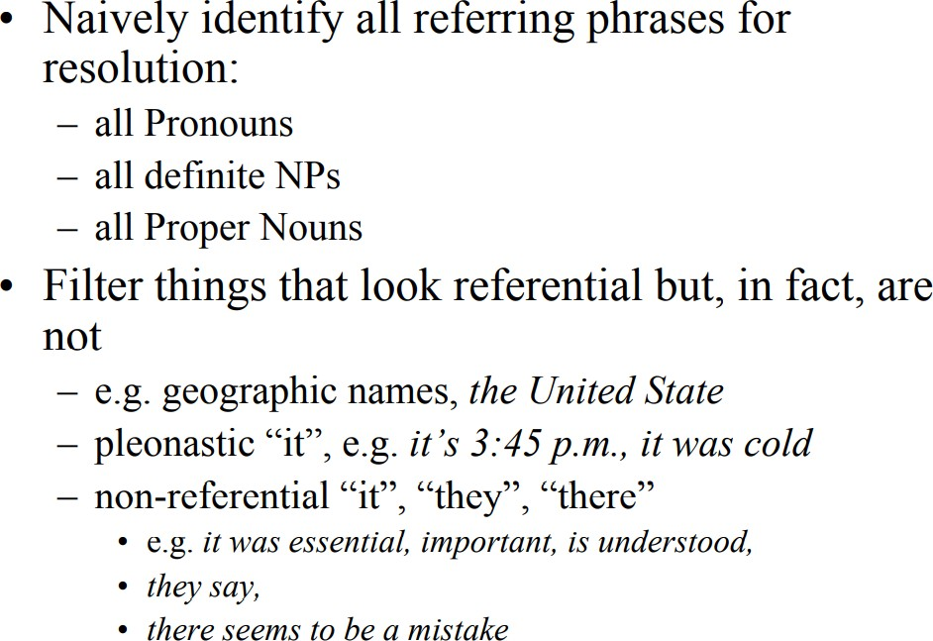
Approach to coreference resolution

Slide 30
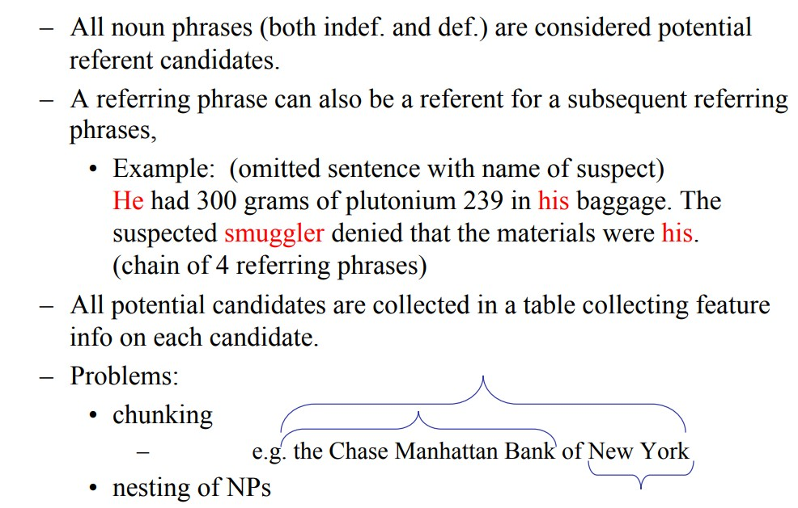
Identify Referent Candidates

Slide 31

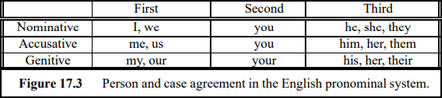

Constraints (English)
A categorization of pronouns with respect to number is shown in Figure 17.2
A categorization of pronouns with respect to person is shown in Figure 17.3.

Slide 32
Constraints (English)
Number Agreement:
To distinguish between singular and plural references.
*John has a new car. They are red.
Gender Agreement:
To distinguish male, female, and non-personal genders.
John has a new car. It is attractive. [It = the new car]
Person and Case Agreement:
To distinguish between three forms of person;
*You and I have Escorts. They love them.
To distinguish between subject position, object position, and genitive position.

Slide 33
Constraints (English)
Syntactic Constraints:
Syntactic relationships between a referring expression and a possible antecedent
noun phrase
John bought himself a new car. [himself=John]
John bought him a new car. [him≠John]
English pronouns such as himself, herself, and themselves are called Reflexives
Selectional Restrictions:
A verb places restrictions on its arguments.
John parked his Acura in the garage. He had driven it around for hours. [it=Acura, it≠garage];
I picked up the book and sat in a chair. It broke

Slide 34
Preferences in Pronoun Interpretation
Recency:
Entities introduced recently are more salient than those introduced before.
John has a Legend. Bill has an Escort. Mary likes to drive it.
Grammatical Role:
Entities mentioned in subject position are more salient than those in object position.
Bill went to the Acura dealership with John. He bought an Escort. [he=Bill]
John went to the Acura dealership with Bill. He bought an Integra. [ he = John ]
John and Bill went to the Acura dealership. He bought an Integra. [ he = ?? ].

Slide 35
Preferences in Pronoun Interpretation
Repeated Mention:
Entities that have been focused on in the prior discourse are more salient. John needed a car to get to his new job.
He decided that he wanted something sporty.
Bill went to the Acura dealership with him. He bought an Integra. [he=John]

Slide 36
Preferences in Pronoun Interpretation
Parallelism (more generally – discourse structure):
There are also strong preferences that appear to be induced by parallelism effects.
Mary went with Sue to the cinema. Sally went with her to the mall. [ her = Sue]
Mary went with Sue to the Acura dealership. Sally told her not to buy anything. [ her = Mary ]
Jim surprised Paul and then Julie shocked him. (him = Paul)

Slide 37
Preferences in Pronoun Interpretation
Verb Semantics:
Certain verbs appear to place a semantically-oriented emphasis on one of their argument positions.
John telephoned Bill. He had lost the book in the mall. [He = John]
John criticized Bill. He had lost the book in the mall. [He = Bill]
David praised Hans because he … [he = Hans]
David apologized to Hans because he… [he = David]

Slide 38
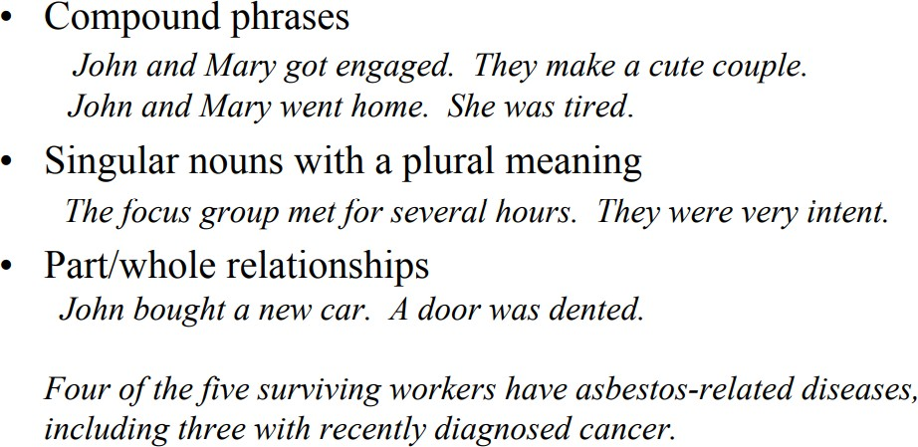
Unusual Cases

Slide 39
Preferences in Pronoun Interpretation
World knowledge in general:
The city council denied the demonstrators a permit because they {feared | advocated} violence.
The city council denied the demonstrators a permit because they {feared |advocated} violence.
The city council denied the demonstrators a permit because they {feared |advocated} violence.

Slide 40
The Plan : Anaphora Resolution
Introduce and compare 3 algorithms for anaphora resolution:
Hobbs Tree Search Algorithm 1978
Lappin and Leass Algorithm 1994
Centering Theory

Slide 41
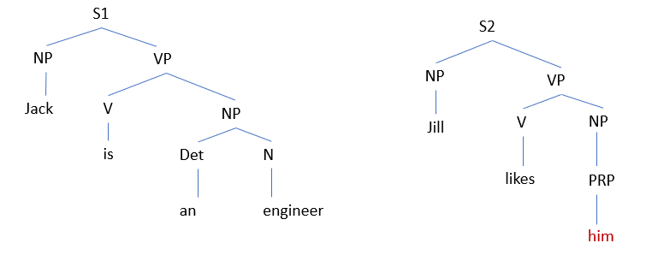
Hobbs Tree Search Algorithm
Hobbs Algorithm is one of the technique used for Pronoun Resolution.
The algorithm is mainly based on the syntactic parse tree of the sentences.
Consider two sentences:
Sentence 1(S1): Jack is an engineer.
Sentence 2 (S2): Jill likes him.

Slide 42
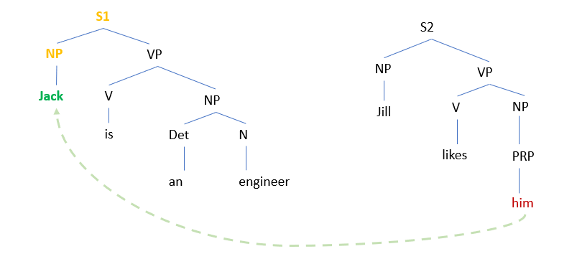
Hobbs

Slide 43
Centering Algorithm
Grosz, Barbara J., Aravind Joshi, and Scott Weinstein. 1995. Centering: A framework for modeling the local coherence of discourse. Computational Linguistics, 21(2):203-225
Centering theory was developed by Barbara J. Grosz, Aravind K. Joshi and Scott Weinstein in the 1980s to explain this kind of phenomena.

Slide 44
Centering Algorithm: Definitions
Utterance – A sentence in the context of a discourse.
Center – An entity referred to in the discourse (our discourse referents).
Forward looking centers – An utterance U_{n} is assigned a set of centers C_{f}(U_{n}) that are referred to in U_{n} (basically, the drefs introduced / accessed in a sentence).
Backward looking center – An utterance U_{n} is assigned a single center C_{b}(U_{n}), which is equal to one of the centers in C_{f}(U_{n-1})∩C_{f}(U_{n}).
If there is no such center, C_{b}(U_{n}) is NIL.

Slide 45
Ranking of Forward looking Centers
C_{f}(U_{n}) is an ordered set.
Its order reflects the prominence of the centers in the utterance.
The ordering (ranking) is done primarily according to the syntactic position of the word in the utterance (subject > object(s) > other).
The prominent center of an utterance, C_{p}(U_{n}), is the highest ranking center in
C_{f}(U_{n}).

Slide 46
Ranking of Forward looking Centers
Think of the backward looking center C_{b}(U_{n}) as the current topic.
Think of the preferred center C_{p}(U_{n}) as the potential new topic.

Slide 47
Constraints on Centering
There is precisely one C_{b}.
Every element of C_{f}(U_{n}) must be realized in U_{n}.
C_{b}(U_{n}) is the highest-ranked element of C_{f}(U_{n-1}) that is realized in U_{n}.

Slide 48
Type of Transitions
Transition Type from U_{n-1} to U_{n} | C_{b}(U_{n}) = C_{b}(U_{n-1}) | C_{b}(U_{n}) = C_{p}(U_{n})
Center Continuation | + | +
Center Retaining | + | -
Center Shifting-1 | - | +
Center Shifting | - | -

Slide 49
Example
U₁. John drives a Ferrari.
U₂. He drives too fast.
U₃. Mike races him often.
U₄. He sometimes beats him.

Slide 50
Example: Let’s See what the centers are..
U₁. John drives a Ferrari.
C_{b}(U₁) = NIL (or: John). C_{f}(U₁) = (John, Ferrari)
U₂. He drives too fast.
C_{b}(U₂) = John. C_{f}(U₂) = (John)
U₃. Mike races him often.
C_{b}(U₃) = John. C_{f}(U₃) = (Mike, John)
U₄. He sometimes beats him.
C_{b}(U₄) = Mike. C_{f}(U₄) = (Mike, John)

Slide 51
Type of Transitions
Transition Type from U_{n-1} to U_{n} | C_{b}(U_{n}) = C_{b}(U_{n-1}) | C_{b}(U_{n}) = C_{p}(U_{n})
Center Continuation | + | +
Center Retaining | + | -
Center Shifting-1 | - | +
Center Shifting | - | -

Slide 52
Let’s See what the transitions are..
U₁. John drives a Ferrari.
C_{b}(U₁) = John. C_{f}(U₁) = (John, Ferrari)
U₂. He drives too fast.
C_{b}(U₂) = John. C_{f}(U₂) = (John)

Slide 53
Type of Transitions
Transition Type from U_{n-1} to U_{n} | C_{b}(U_{n}) = C_{b}(U_{n-1}) | C_{b}(U_{n}) = C_{p}(U_{n})
Center Continuation | + | +
Center Retaining | + | -
Center Shifting-1 | - | +
Center Shifting | - | -

Slide 54
Let’s See what the transitions are..
U₁. John drives a Ferrari.
C_{b}(U₁) = John. C_{f}(U₁) = (John, Ferrari)
U₂. He drives too fast. (Continuation) C_{b}(U₂) = John. C_{f}(U₂) = (John)
U₃. Mike races him often.
C_{b}(U₃) = John. C_{f}(U₃) = (Mike, John)

Slide 55
Type of Transitions
Transition Type from U_{n-1} to U_{n} | C_{b}(U_{n}) = C_{b}(U_{n-1}) | C_{b}(U_{n}) = C_{p}(U_{n})
Center Continuation | + | +
Center Retaining | + | -
Center Shifting-1 | - | +
Center Shifting | - | -

Slide 56
Let’s See what the transitions are..
U₁. John drives a Ferrari.
C_{b}(U₁) = John. C_{f}(U₁) = (John, Ferrari)
U₂. He drives too fast. (Continuation) C_{b}(U₂) = John. C_{f}(U₂) = (John)
U₃. Mike races him often. (Retaining)
C_{b}(U₃) = John. C_{f}(U₃) = (Mike, John)
U₄. He sometimes beats him.
C_{b}(U₄) = Mike. C_{f}(U₄) = (Mike, John)

Slide 57
Type of Transitions
Transition Type from U_{n-1} to U_{n} | C_{b}(U_{n}) = C_{b}(U_{n-1}) | C_{b}(U_{n}) = C_{p}(U_{n})
Center Continuation | + | +
Center Retaining | + | -
Center Shifting-1 | - | +
Center Shifting | - | -

Slide 58
Let’s See what the transitions are..
U₁. John drives a Ferrari.
C_{b}(U₁) = John. C_{f}(U₁) = (John, Ferrari)
U₂. He drives too fast. (Continuation) C_{b}(U₂) = John. C_{f}(U₂) = (John)
U₃. Mike races him often. (Retaining)
C_{b}(U₃) = John. C_{f}(U₃) = (Mike, John)
U₄. He sometimes beats him. (Shifting - I) C_{b}(U₄) = Mike. C_{f}(U₄) = (Mike, John)

Slide 59
Centering Rules in Discourse
If some element of C_{f}(U_{n-1}) is realized as a pronoun in U_{n}, then so is C_{b}(U_{n}).
Continuation is preferred over retaining, which is preferred over shifting-1, which is preferred over shifting:
Continuation >> Retain >> Shift-1 >> Shift

Slide 60
Violation of Rule 1
Assuming He in utterance U₁ refers to John…
U₁. He has been acting quite odd.
U₂. He called up Mike Yesterday.
U₃. John wanted to meet him urgently.

Slide 61
Violation of Rule 1 in more detail…
U₁. He has been acting quite odd. C_{b}(U₁) = John. C_{f}(U₁) = (John)
U₂. He called up Mike Yesterday. C_{b}(U₂) = John. C_{f}(U₂) = (John, Mike)
U₃. John (Proper Noun) wanted to meet him(Pronoun) urgently. C_{b}(U₃) = John. C_{f}(U₃) = (John, Mike)

Slide 62
Violation of Rule 2…
Compare the two discourses we started with:
U₁. John went to his favorite music store to buy a piano.
U₂. He had frequented the store for many years.
U₃. He was excited that he could finally buy a piano.
U₄. He arrived just as the store was closing for the day.
U₁. John went to his favorite music store to buy a piano.
U₂. It was a store John had frequented for many years.
U₃. He was excited that he could finally buy a piano.
U₄. It was closing just as John arrived.

Slide 63
Transition for the 1st Discourse..
U₁. John went to his favorite music store to buy a piano.
C_{b}(U₁) = John. C_{f}(U₁) = (John, store, piano).
U₂. He had frequented the store for many years. C_{b}(U₂) = John. C_{f}(U₂) = (John, store). CONT
U₃. He was excited that he could finally buy a piano. C_{b}(U₃) = John. C_{f}(U₃) = (John, piano). CONT
U₄. He arrived just as the store was closing for the day. C_{b}(U₄) = John. C_{f}(U₄) = (John, store). CONT

Slide 64
Transition for the 2nd Discourse..
U₁. John went to his favorite music store to buy a piano.
C_{b}(U₁) = John. C_{f}(U₁) = (John, store, piano).
U₂. It was a store John had frequented for many years.
C_{b}(U₂) = John. C_{f}(U₂) = (store, John). RETAIN
U₃. He was excited that he could finally buy a piano. C_{b}(U₃) = John. C_{f}(U₃) = (John, piano). CONT
U₄. It was closing just as John arrived.
C_{b}(U₄) = John. C_{f}(U₄) = (store, John). RETAIN

Slide 65
Previous Example..
U₁: John saw a beautiful Acura Integra at the dealership.
C_{b}(U₁) = John / NIL. C_{f}(U₁) = (John, Integra, dealership).
U₂: He showed it to Bob.
C_{b}(U₂) = John. C_{f}(U₂) = (John, Integra, Bob) CONT – highest rank
But: C_{b}(U₂) = John. C_{f}(U₂) = (John, dealership, Bob) CONT
U₃: He bought it.
C_{b}(U₃) = John. C_{f}(U₃) = (John, Integra) CONT √ (as per Rule 2)
C_{b}(U₃) = Integra. C_{f}(U₃) = (Bob, Integra) SHIFT (Smooth-Shift)

Slide 66
General Structure of Centering Algorithm
For each utterance perform the following steps
Anchor construction:
Create all possible anchors (pairs of forward centers and a backward center).
Anchor filtering:
Filter out the bad anchors according to various filters.
Anchor ranking:
Rank the remaining anchors according to their transition type.

Slide 67
General Structure of Centering Algorithm
This is very similar to the general architecture of the algorithm in Lappin & Leass 1994:
First: filtering based on hard constraints
Then: ranking based on some soft constraints

Slide 68
Centering Algorithm Vs Hobbs
Marilyn A. Walker. 1989, Evaluating discourse processing algorithms. In Proceedings of ACL 27, Vancouver, British Columbia, 251-261.
Walker 1989 manually compared a version of centering to Hobbs on 281
examples from three genres of text.
Reported 81.8% for Hobbs, 77.6% centering

Slide 69
Centering Algorithm : Exercise
Bob opened up a new dealership last week.
John took a look at the Acuras in his lot.
He ended up buying one.

